Slide 1

DEPARTMENT OF COMPUTER SCIENCE AND ENGINEERING INDUSTRIAL-ORIENTED MAJOR PROJECT
A USER CENTRIC MACHINE LEARNING FRAMEWORK FOR CYBER
SECURITY OPERATION CENTER
CLASS/SECTION: CSE IV-A | BATCH: 2
BATCH MEMBERS :
ANUSHKA KUMARI | 19W91A0515
BASIREDDY RUDRATEJA REDDY | 19W91A0529
BONGU SAI KIRAN | 19W91A0538
CHEPURI SHYNITHA | 19W91A0548
UNDER THE ESTEEMED GUIDANCE OF :
Mr. M NAGENDRA RAO
ASSISTANT PROFESSOR, CSE

Slide 2
CONTENTS
ABSTRACT
EXISTING SYSTEM AND ITS LIMITATIONS
PROPOSED SYSTEM
SOFTWARE AND HARDWARE REQUIREMENTS
SOFTWARE ARCHITECTURE AND UML DIAGRAMS
MODULES
CODE EXPLANATIONS
OUTPUT SCREENS
TEST CASES
CONCLUSION
REFERENCES

Slide 3
ABSTRACT
In order to ensure a company's Internet security, SIEM (Security Information and Event Management) system is in place to simplify the various preventive technologies and flag alerts for security events. Inspectors (SOC) investigate warnings to determine if this is true or not. The number of warnings in general is wrong with the majority and is more than the ability of SCO to handle all awareness. Because of this, malicious possibility. Attacks and compromised hosts may be wrong.
We create a user-centric engineer learning framework for the Internet Safety Functional Center in the real organizational context using Machine Learning approach. This system aims two group of readers. First group readers are one who have no knowledge of data scientists or computer safety fields and second group readers are Internet security practitioners that have deep knowledge and expertise in Cyber Security
The system aims to demonstrate full steps from data collection, label creation, feature engineering, machine learning algorithm and sample performance evaluations.

Slide 4
EXISTING SYSTEM AND ITS LIMITATIONS
Most approaches to security in the enterprise have focused on protecting the network infrastructure with no or little attention to end users
Traditional security functions uses firewalls and intrusion detection deal mainly with network level protection
Data Analysis for Network Cyber-Security focuses on monitoring and analyzing network traffic data, with the intention of preventing malicious activity
Risk values were introduced in an (ISMS), SCADA system as a critical infrastructure using real-time monitoring
LIMITATIONS
Firewalls can be difficult to configure correctly.
Need to keep updating the new software in order to keep security up to date.
Could be costly for average user.
The user is the only constant.

Slide 5
PROPOSED SYSTEM
User-centric cyber security helps enterprises reduce the risk associated with fast-evolving end-user realities by reinforcing security closer to end users
Preserve the integrity of the enterprise network and its assets.
Protects the network from the user — securing it against vulnerabilities that user needs introduce.
Used in many application domains.
Main scope of this project in reduce the unwanted data for the dataset.
ADVANTAGES
Protection against data from theft.
Protects the computer from being hacked.
Minimizes computer freezing and crashes.
Securing the user-aware network edge.

Slide 6
SOFTWARE AND HARWARE REQUIREMENTS
SOFTWARE REQUIREMENTS :
Operating system Windows 7 Ultimate and above versions
Coding Language Python (version 3.7)
Front-End HTML, CSS , Javascript.
Data Base MySQL
Web Framework Django
HARDWARE REQUIREMENTS :
System Pentium IV 2.4 GHz.
Hard Disk 40 GB.
Floppy Drive 1.44 Mb.
Monitor 14’ Colour Monitor.
Mouse Optical Mouse.
Ram 512 Mb.

Slide 7
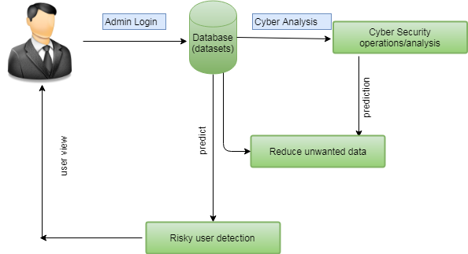
SOFTWARE ARCHITECTURE

Slide 8
UML DIAGRAMS
The diagrams that are employed to design this project are:
Class diagram
Use Case diagram
Sequence diagram
Collaboration diagram
Activity diagram

Slide 9
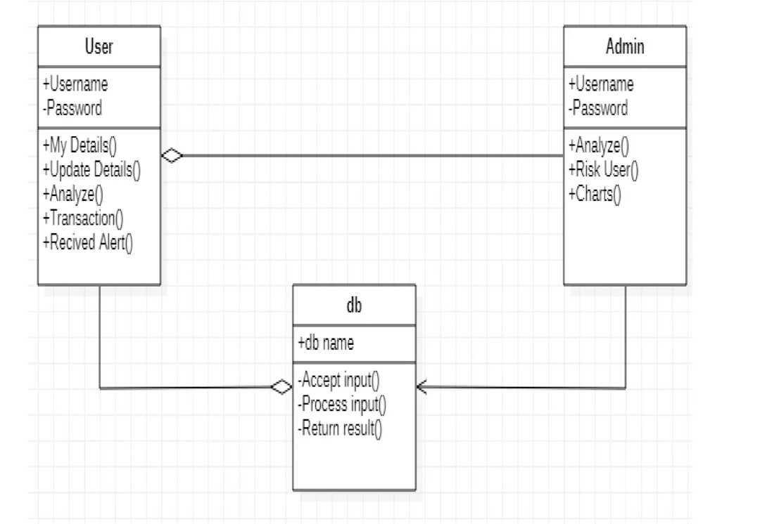
CLASS DIAGRAM
Use Case Diagram of the System

Slide 10
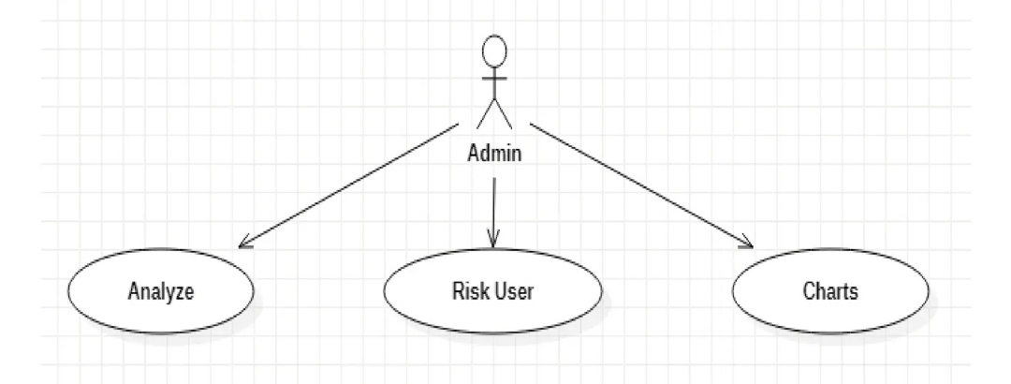
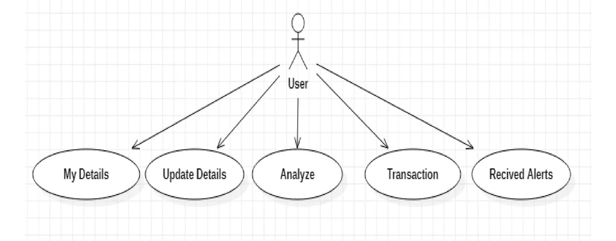
USE CASE DIAGRAM
User Use Case Diagram
Admin Use Case Diagram

Slide 11
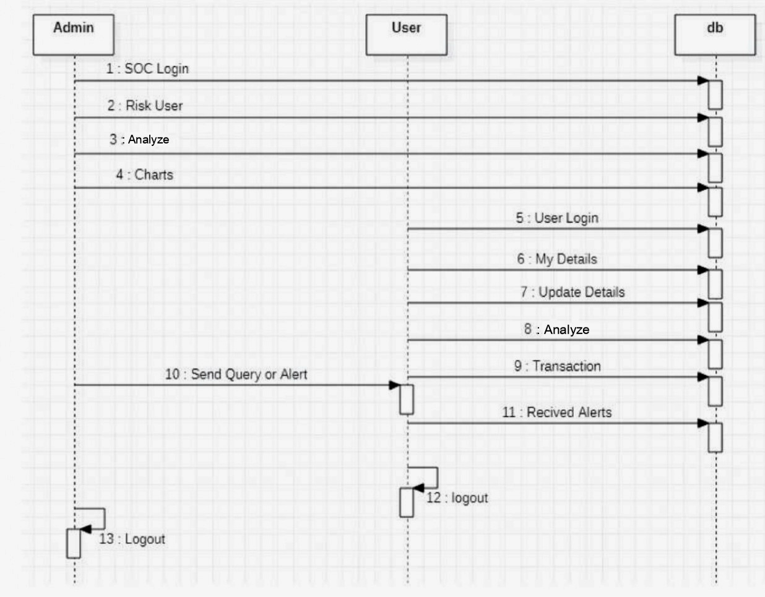
SEQUENCE DIAGRAM
Sequence diagram of the System

Slide 12
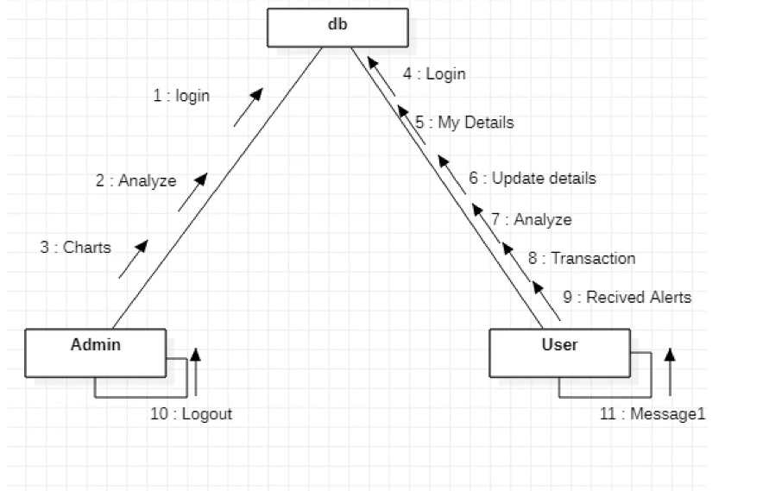
COLLABORATION DIAGRAM
Collaboration diagram of the System

Slide 13
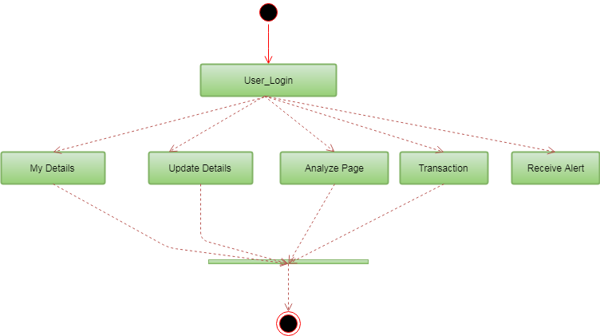
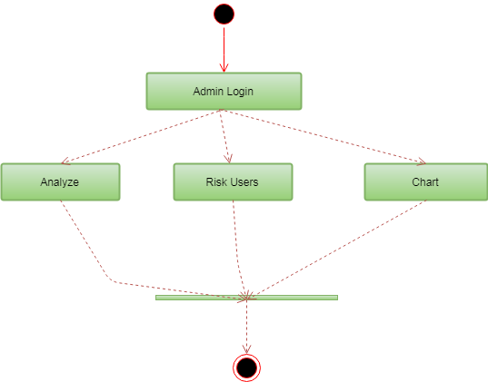
ACTIVITY DIAGRAM
User Activity Diagram
Admin Activity Diagram

Slide 14
MODULES
MODULES
DATA REDUCTION
RISK USER DETECTION
DATASET MODIFICATION
CYBER ANALYSIS

Slide 15
MODULES
1. CYBER ANALYSIS
It is a process in which the knowledge of internal and external information vulnerabilities pertinent to a particular organization is matched against real-world cyber-attacks.
this threat-oriented approach to combating cyber-attacks represents a smooth transition from a state of reactive security to a state of proactive one.
give best practices on how to maximize the protective instruments
2. DATASET MODIFICATION
If a dataset in your dashboard contains many dataset objects, you can hide specific dataset objects from display in the Datasets panel.
For example, if you decide to import a large amount of data from a file, you can hide the unwanted attributes and metrics.

Slide 16
MODULES
3. DATA REDUCTION
Improve storage efficiency through data reduction techniques and capacity optimization.
Capacity is optimized using data reduplication, compression, snapshots and thin provisioning.
Data reduction via simply deleting unwanted or unneeded data is the most effective way to reduce a storing’s data
4. RISK USER DETECTION
False alarm immunity to prevent customer embarrassment.
High detection rate to protect all kinds of goods from theft.
Wide-exit coverage offers greater flexibility for entrance/exit layouts.
Sophisticated digital controller technology for optimum system performance.
.

Slide 17
CODE EXPLANATION
MACHINE LEARNING TECHNIQUES AND ALGORITHM USED
MACHINE LEARNING
Machine Learning is said as a subset of artificial intelligence that is mainly concerned with the development of algorithms which allow a computer to learn from the data and past experiences on their own.
It brings computer science and statistics together for creating predictive models and it also constructs or uses the algorithms that learn from historical data.
It learns from historical data, builds the prediction models, and whenever it receives new data, predicts the output for it. The accuracy of predicted output depends upon the amount of data.
SUPERVISED MACHINE LEARNING
learning method in which we provide sample labeled data to the machine learning system in order to train it, and on that basis, it predicts the output.
The system creates a model using labeled data to understand the datasets and learn about each data, once the training and processing are done
we test the model by providing a sample data to check whether it is predicting the exact output or not.

Slide 18

CODE EXPLANATION
MACHINE LEARNING TECHNIQUES AND ALGORITHM USED
SUPPORT VECTOR MACHINE ALGORITHM
SVM is one of the most popular Supervised Learning algorithms, which is used for Classification as well as Regression problems.
The goal of the SVM algorithm is to create the best line or decision boundary that can segregate n-dimensional space into classes so that we can easily put the new data point in the correct category in the future.
This best decision boundary is called a hyperplane, It chooses the extreme points/vectors that help in creating the hyperplane.

Slide 19
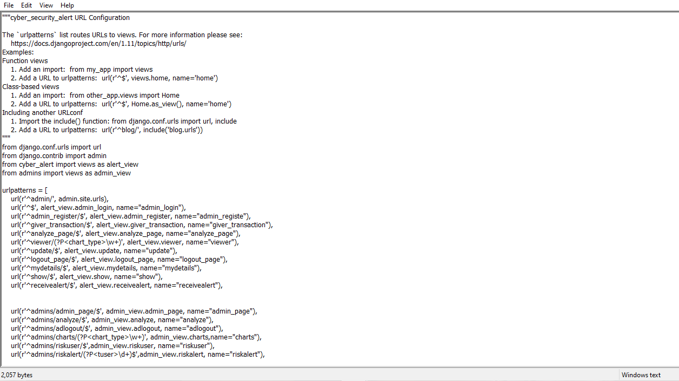
CODE EXPLANATION
Urls.py web pages and other content are delivered by views. View is chosen by examining the URL that's requested (to be precise, the part of the URL after the domain name).
urls.py (cyber_security_alert)

Slide 20
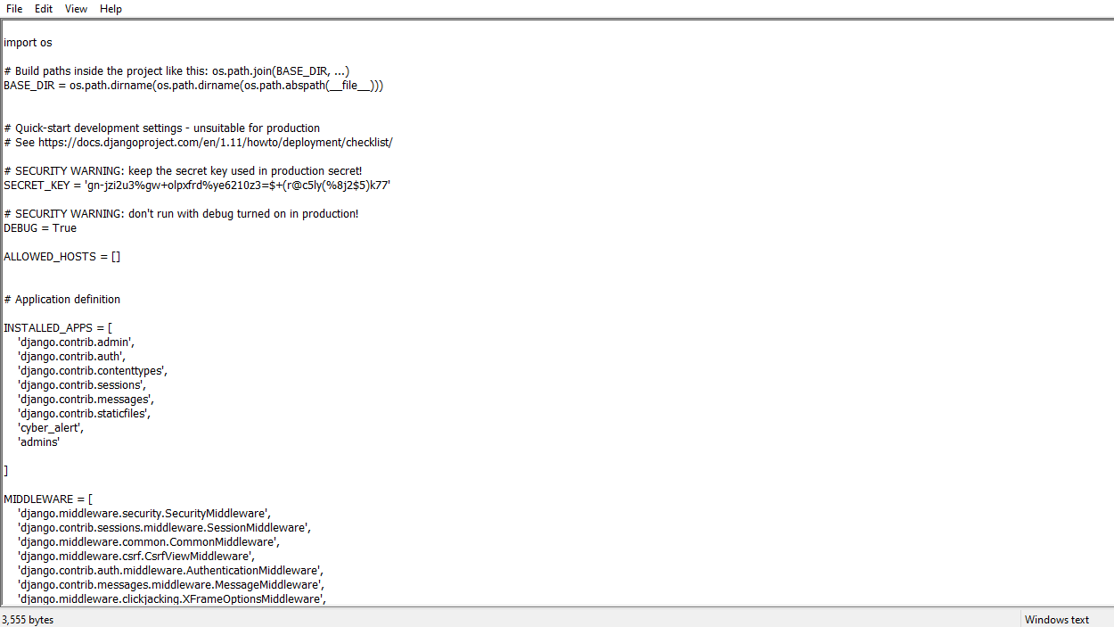
CODE EXPLANATION
Settings.py is a core file in Django projects. It holds all the configuration values that your web app needs to work; database settings, logging configuration, where to find static files.
settings.py (cyber_security_alert)

Slide 21
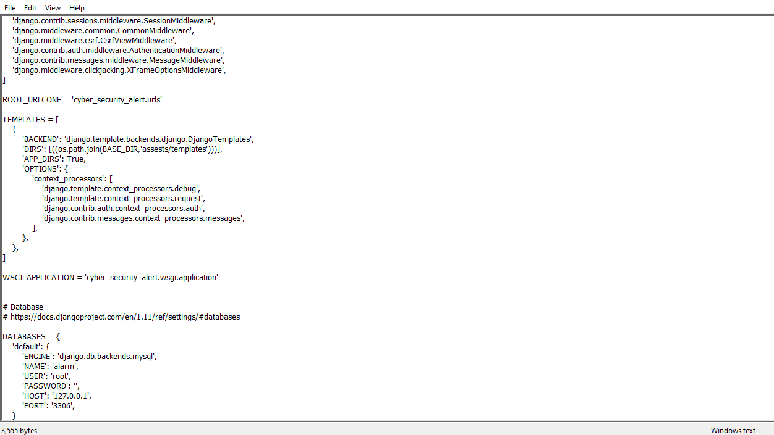
CODE EXPLANATION
Settings.py

Slide 22
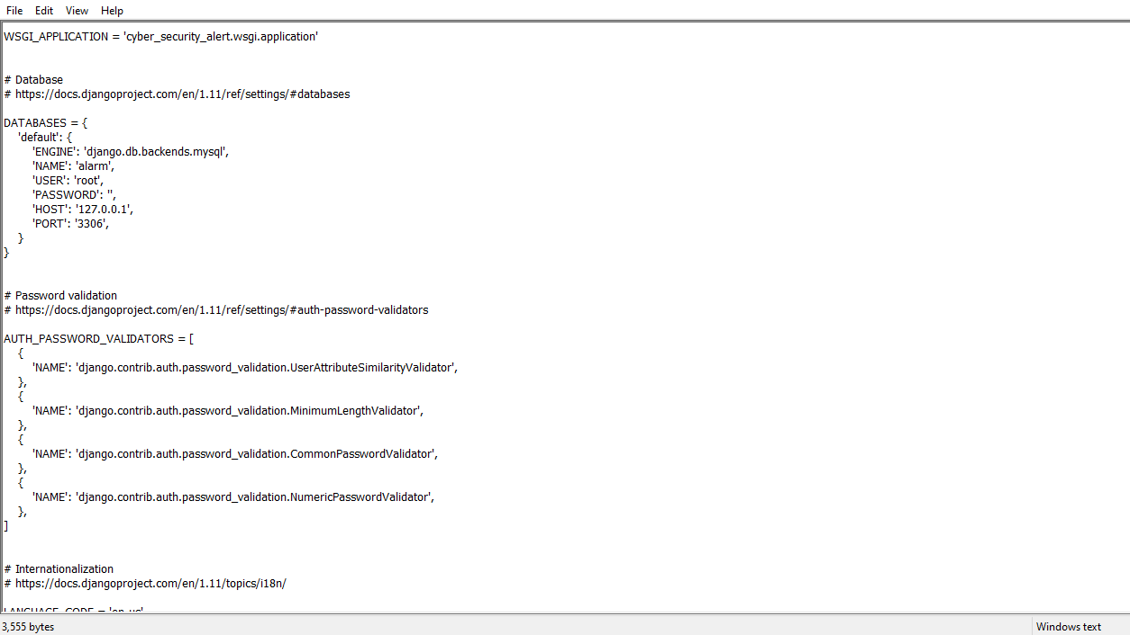
CODE EXPLANATION
Settings.py

Slide 23
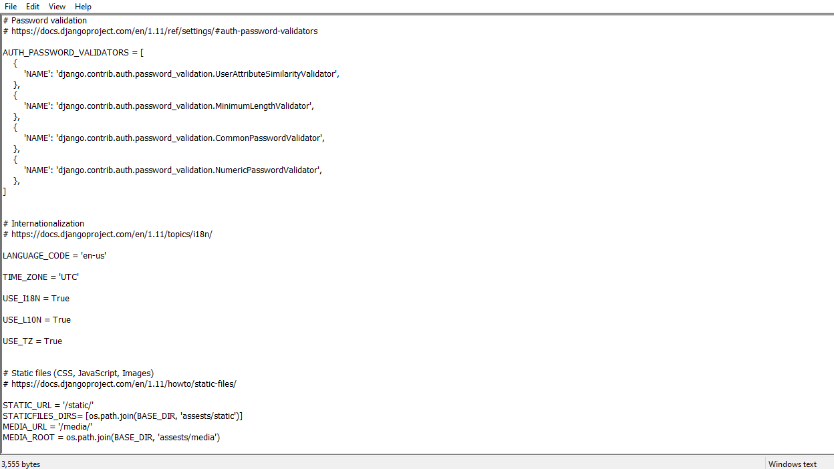
CODE EXPLANATION
Settings.py

Slide 24
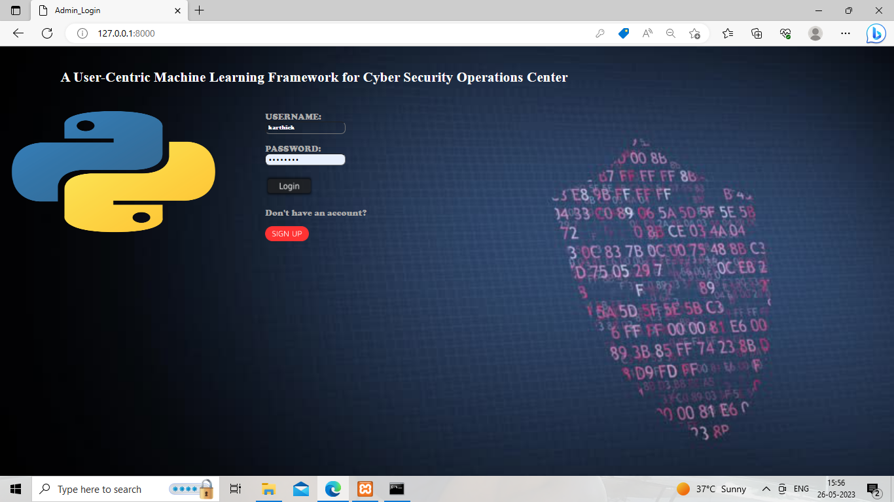
OUTPUT SCREENS
USER LOGIN PAGE

Slide 25
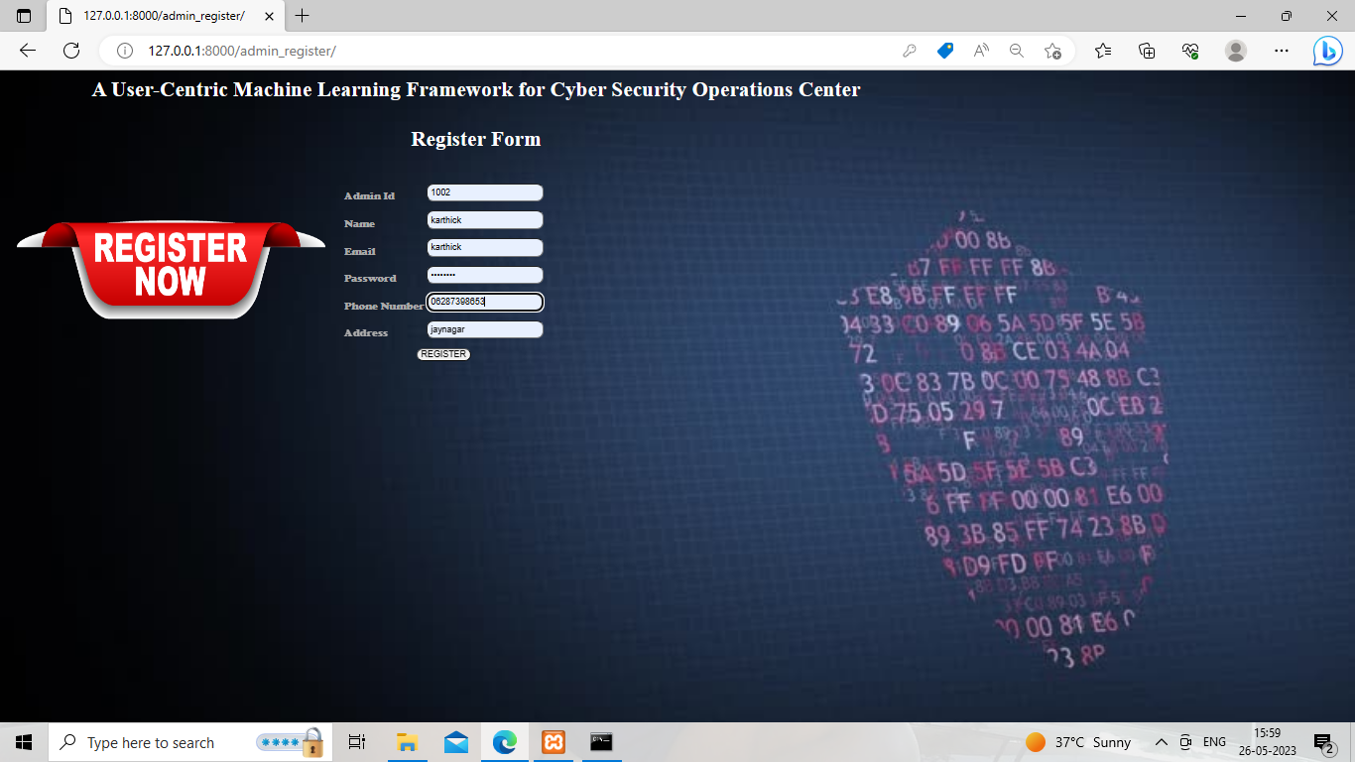
OUTPUT SCREENS
USER REGISTER PAGE

Slide 26
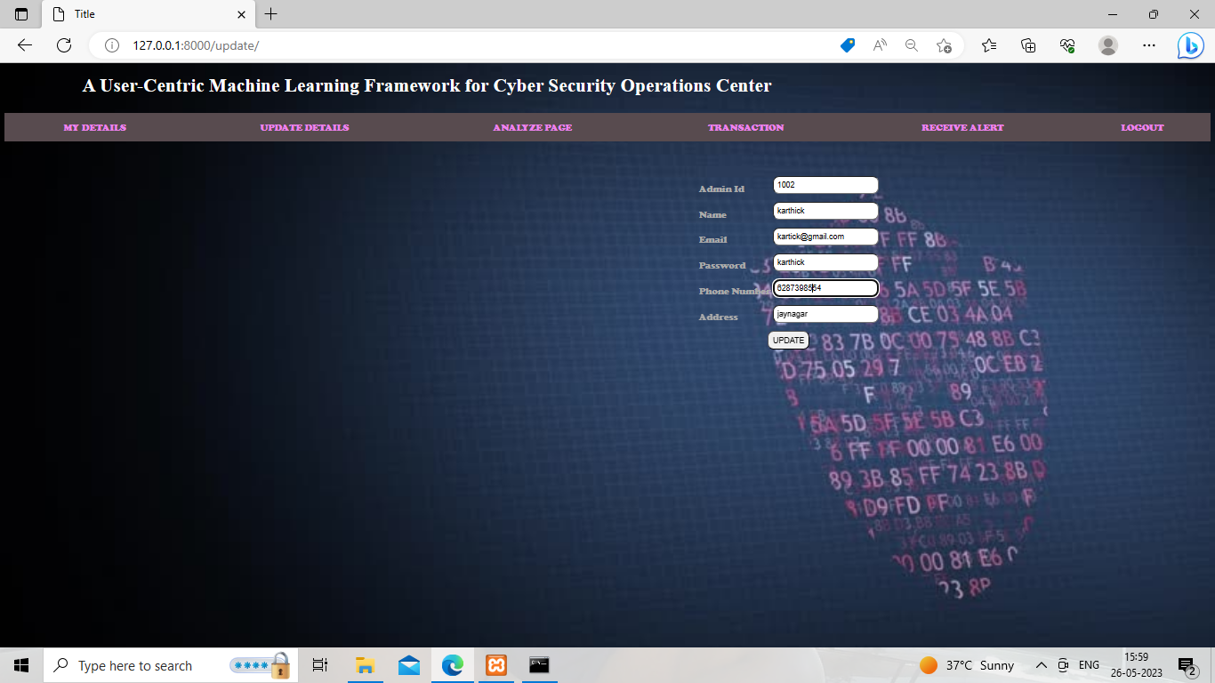
OUTPUT SCREENS
USER UPDATE PAGE

Slide 27
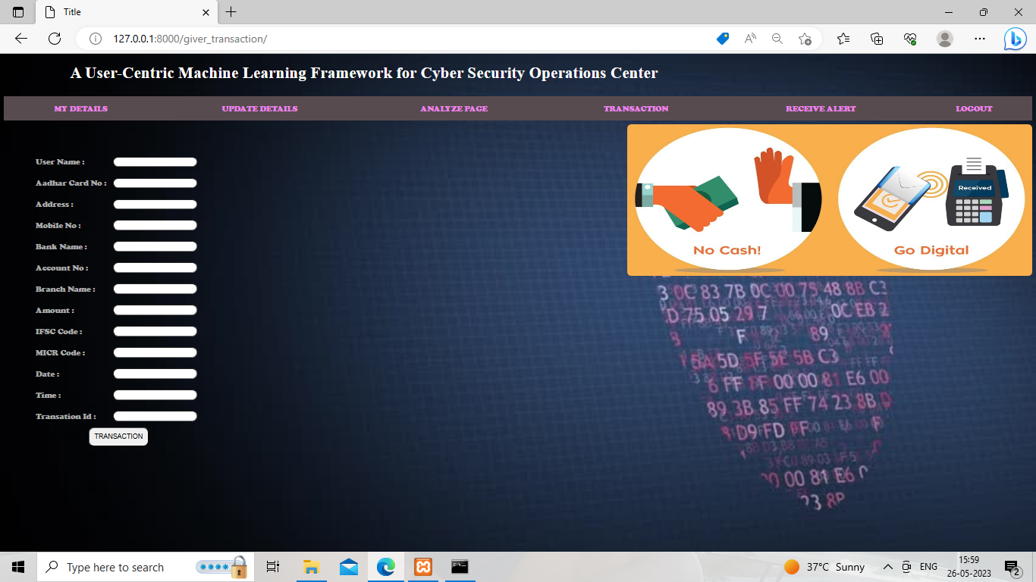
OUTPUT SCREENS
USER TRANSACTION PAGE

Slide 28
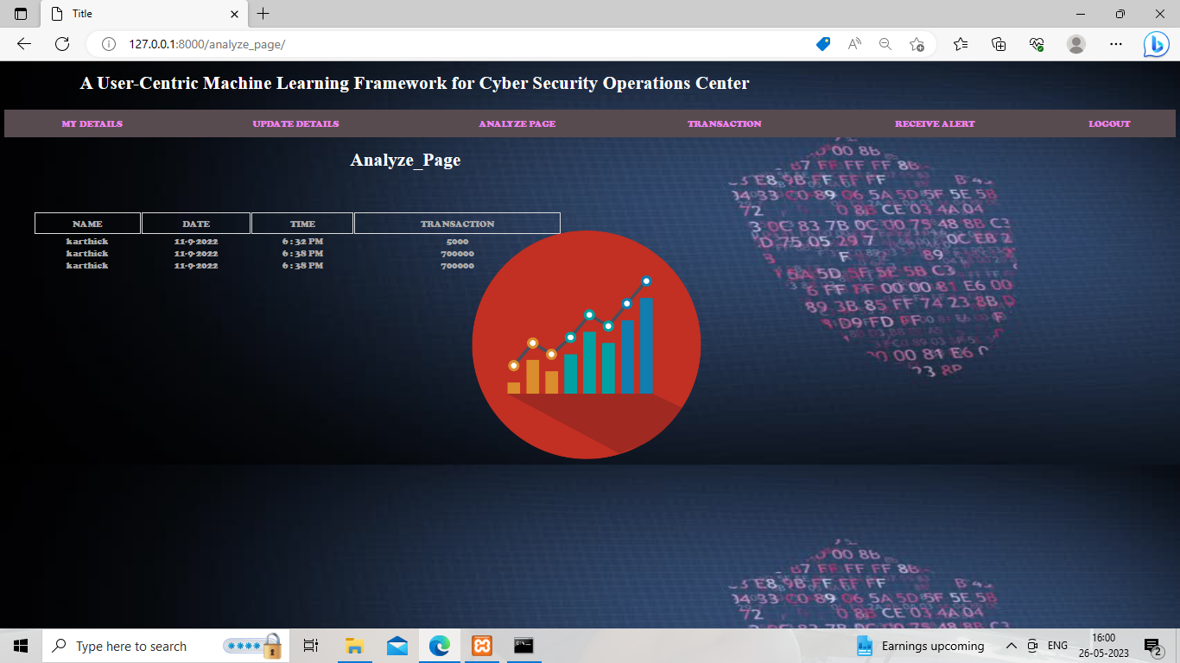
OUTPUT SCREENS
USER ANALYZE PAGE

Slide 29
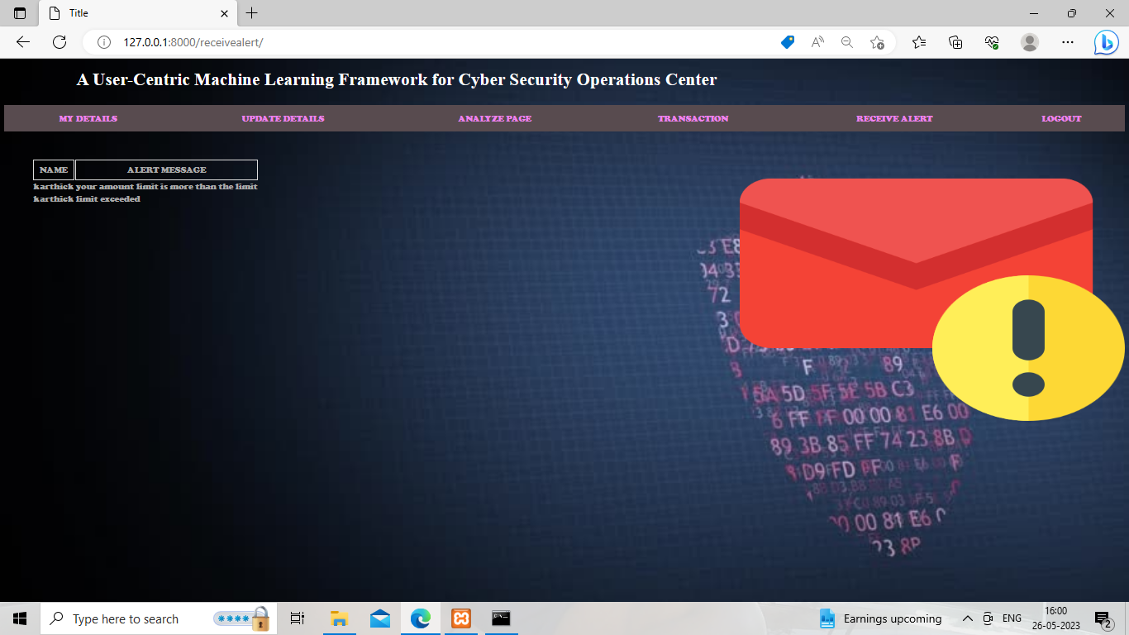
OUTPUT SCREENS
USER RECIEVE ALERT PAGE

Slide 30
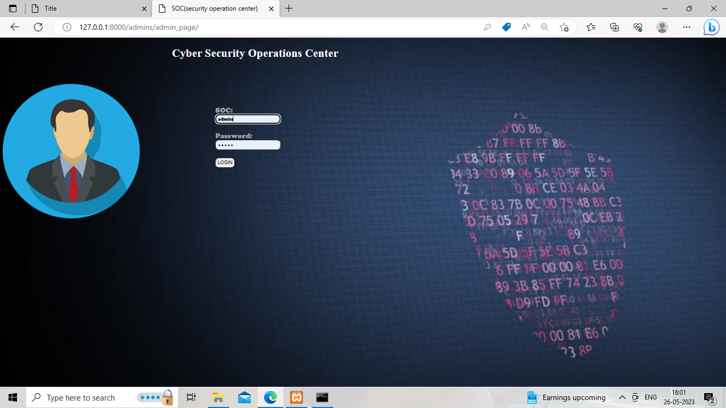
OUTPUT SCREENS
ADMIN LOGIN PAGE

Slide 31
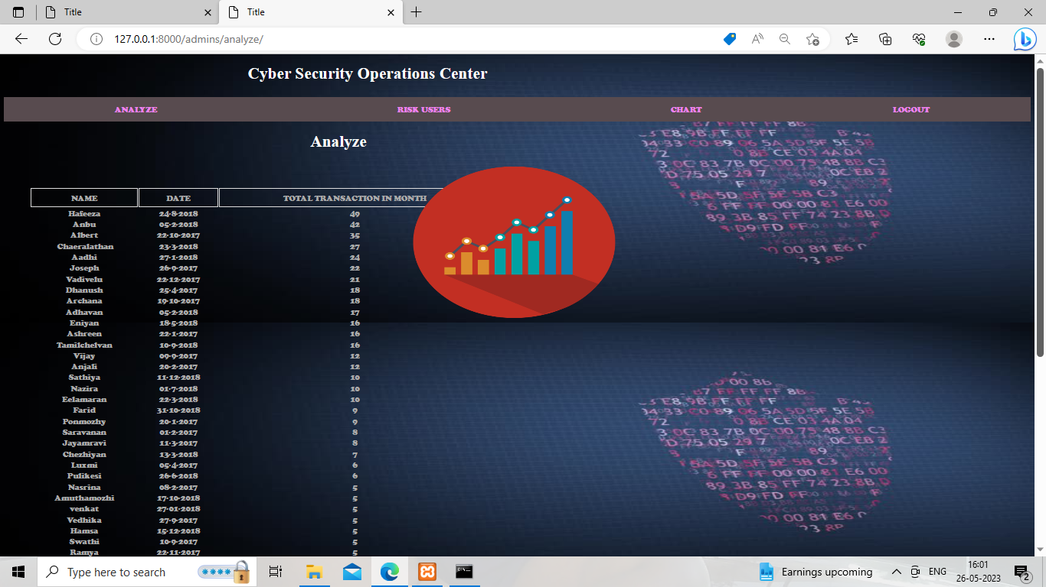
OUTPUT SCREENS
ADMIN ANALYZE PAGE

Slide 32
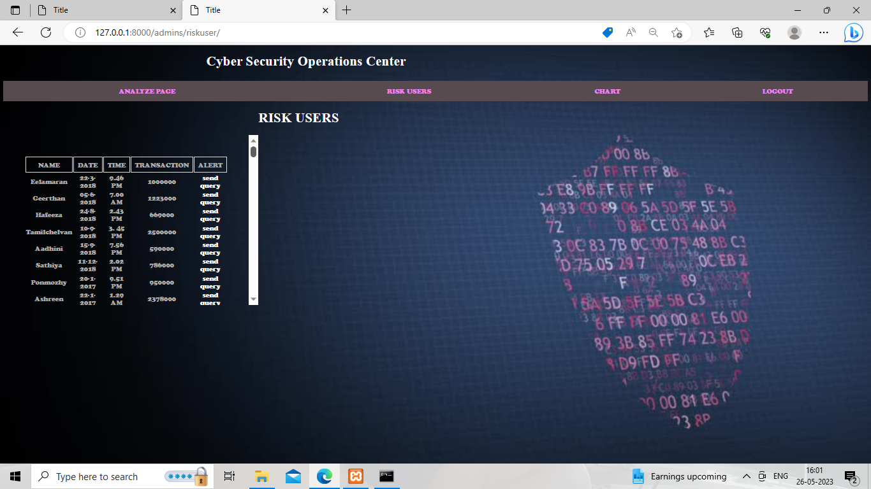
OUTPUT SCREENS
ADMIN RISK USER PAGE

Slide 33
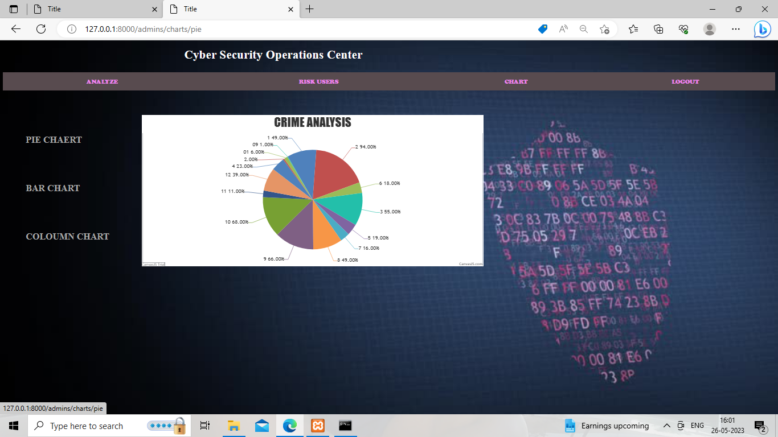
OUTPUT SCREENS
ADMIN CHARTS PAGE (ANALYSIS USING PIE CHART)

Slide 34
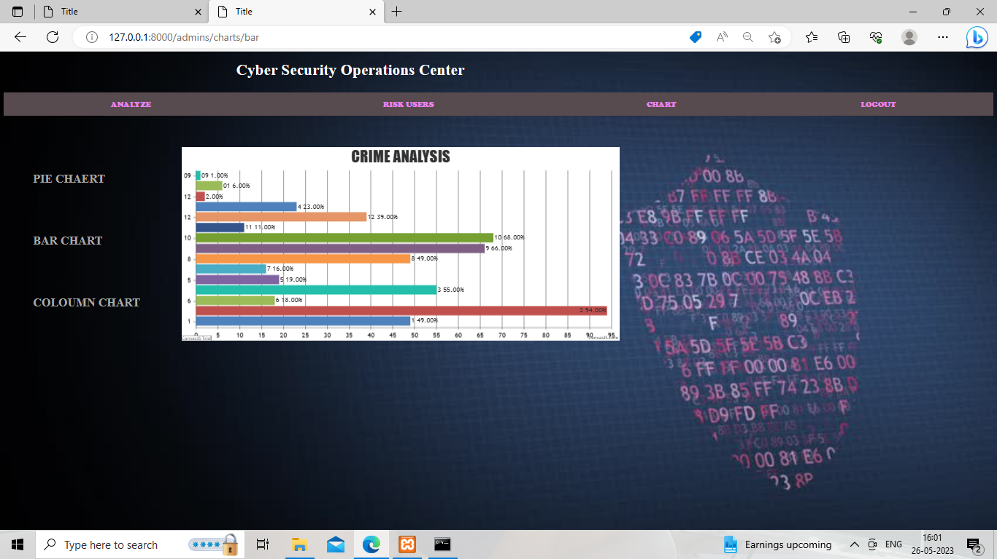
OUTPUT SCREENS
ADMIN CHARTS PAGE (ANALYSIS USING BAR CHART)

Slide 35
TEST CASES
USER TEST CASES
S.no | Test Cases | Expected Output | Result | Remarks (if fails)
1 | User Register | If user registered is successful | Pass | If already user exists
2 | User Login | If user name and password is correct, it will validate user login. | Pass | Unknown users will not login
3 | User details update | If user wants to change their personal details. | Pass | No such detail/No valid proof exists
4 | User Transaction page | User should enter their details for transaction, with primary ID | Pass | Transaction fails if wrong details entered.
5 | User Analyze page | User can view all the transaction list performed till date | Pass | Cannot Analyze with failed transactions.
6 | User Alert Page | Alerts user about transactions exceeded the limit | Pass | Doesn’t make alert for transactions within limit

Slide 36
TEST CASES
ADMIN TEST CASES
S.no | Test Cases | Expected Output | Result | Remarks (if fails)
1 | Admin Login | If Admin name and password is correct, it will validate login. | Pass | No valid detail of admin exists
2 | Admin Analyze Page | Show no. of transactions per person registered. | Pass | Fail to show list of no of transactions performed by each user.
3 | Admin Alert Page | Shows details of users who have exceeded transaction limit. | Pass | Fail to view list of exceeded transaction limit users.
4 | Send Query Page | Sends alert message for relevant user exceeding transaction limit. | Pass | Fails to send alert message
5 | Admin Chart Page | Represents Analysis in diagrammatical format in the form of piecharts /bar graph / column graph | Pass | Fails to display diagrammatical representation

Slide 37
CONCLUSION
We provide a user-centered computer learning system that affects large data from various security logs, awareness information, and inspector intelligence.
This method provides complete configuration and solution for dangerous user detection for the Enterprise System Operating Center.
Even with simple mechanical learning algorithms, we prove that the learning system can understand more insights from the rankings with the most unbalanced and limited labels.
FUTURE SCOPE
We will research other learning algorithms to further improve the detection accuracy.
Increase the security with more new ways for securing the user operations.
In SOC as an SOC Analyst we keep our efforts to find more new ways of finding an attack and implement changes needed to protect the organization from cyber threat.

Slide 38
REFERENCES
REFERRED TEXTBOOKS
Unified Modeling Language: by Grady Booch, James Rumbaugh Ivar Jacobson
Python Programming by Taneja Sheetal and Kumar Naveen
Web Development with Django by Ben Shaw, Saurabh Badhwar, Bharat Chandra K S, Chris guest
Python Machine Learning, 2nd edition by Sebastian Raschka Vahid Mirjalili
REFERRED JOURNALS
Yaswanth Sai Raj and J. Rene Beulah (2019). "Securing Identification Card Against Unauthorized Access", International Journal of Engineering and Advanced Technology, vol.8, Issue-3S, pp. 550-553.
Nalini, M. and Anbu, S., "Anomaly Detection Via Eliminating Data Redundancy and Rectifying Data Error in Uncertain Data Streams", Published in International Journal of Applied Engineering Research (IJAER), Vol. 9, no. 24, 2014.

Slide 39
REFERENCES
REFERRED JOURNALS
M.M. Gamal, B. Hasan, and A.F. Hegazy, "A Security Analysis Framework Powered by an Expert System," International Journal of Computer Science and Security (IJCSS), Vol. 4, no. 6, pp. 505-527, Feb. 2011.
S. Poonia, A. Bhardwaj, G. S. Dangayach, (2011) "Cyber Crime: Practices and Policies for Its Prevention", The First International Conference on Interdisciplinary Research and Development, Special No. of the International Journal of the Computer, the Internet and Management, Vol. 19, No. SP1.
REFFERED WEBSITES
https://www.w3schools.com/python/
https://www.javatpoint.com/machine-learning
https://www.tutorialspoint.com/django/index.htm
https://towardsdatascience.com/support-vector-machines-svm
https://www.ijraset.com/research-paper/cyber-security-operations-centre

Slide 40


